Slide 1
Penalized regression with Bayesian Shrinkage Priors and Application to Real-World Data
ENAR 2023
ARINJITA BHATTACHARYYA, MERCK & CO., INC.
RITEN MITRA, UNIVERSITY OF LOUISVILLE

Slide 2

Content
Penalized Regression
Bayesian Shrinkage Priors
Categorical Response Models
Count Response Models
Results
Simulations
Data applications
Discussion

Slide 3
Objective
Bayesian Shrinkage Priors
Penalized Regression
Response: Count and Categorical
Logistic & Negative Binomial
Horseshoe, Dirichlet Laplace, Double Pareto
Lasso, Ridge, Elastic Net

Slide 4

Overview
Clinical outcome depends on several demographic and genetic factors that lead to modification of treatment recommendations and subgroup-specific treatment allocation -– “right drug to the right patient”
Human epidermal growth factor receptor 2 (HER2) gene controls the rapid growth and spread of breast cancer and researchers have developed HER2 protein blocking medical products such as trastuzumab
Prediction of hospitalization risk of COVID-19 positive patients (BMI, sex, age, comorbidities)
Anticipate the risk of 30-day hospital readmission to avoid penalties for hospitals under Medicare’s Hospital Readmissions Reduction program
Need for efficient predictive and machine learning algorithms

Slide 5
Main Goals
Computationally efficient regression model with categorical and count outcomes
Variable selection with Bayesian shrinkage priors
Predictive performance using novel posterior schemes
Application to a wide range of datasets including colon cancer, Alzheimer’s disease, and diabetes

Slide 6


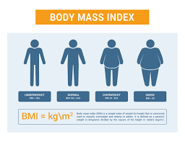
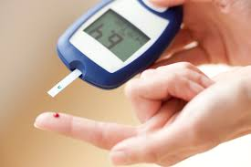

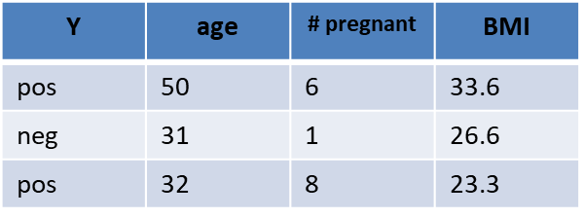
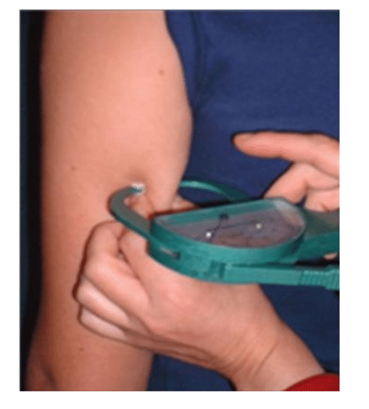
Regression
Curse of Dimensionality
What factors determine if a person has diabetes?
Pregnant
BMI
Age
Triceps Skin fold
Smoking. Genes,
alcohol addiction
Pregnant
BMI
Marriage, Transportation, House loan, Tax, several genes

Slide 7
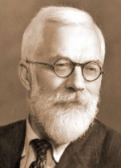
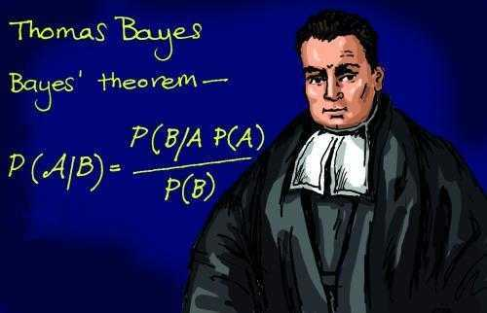
Tackling High Dimensions
Research Goal Simultaneously select important variables and achieve good predictions
Lasso,
Ridge Regression
Frequentist
Shrinkage Priors
Bayesian

Slide 8
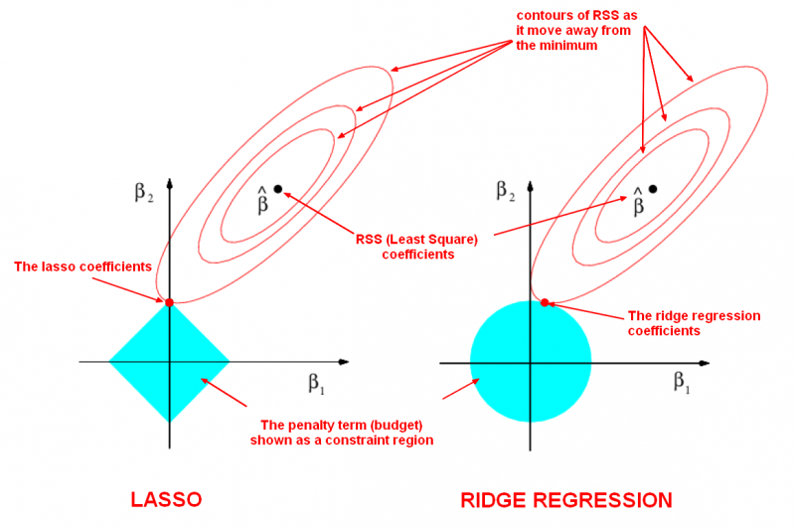

Penalized Regression

Slide 9
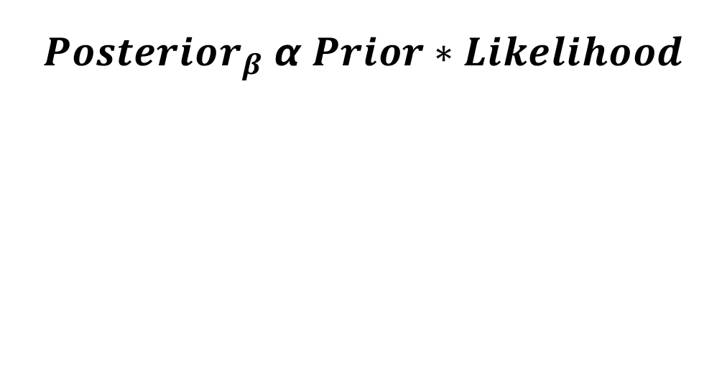

Model Fitting and Prediction
Posterior distribution
of
Estimated coefficients
Predicted Response

Slide 10
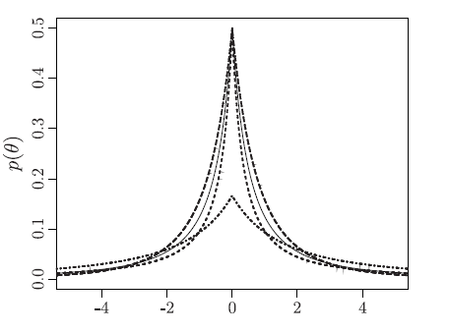
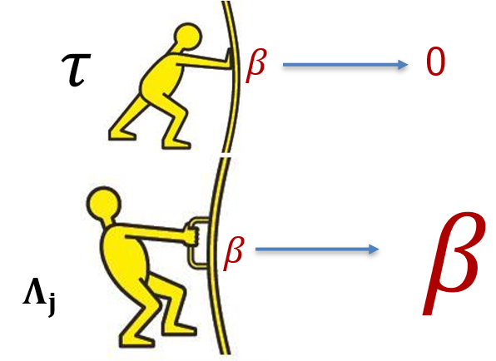

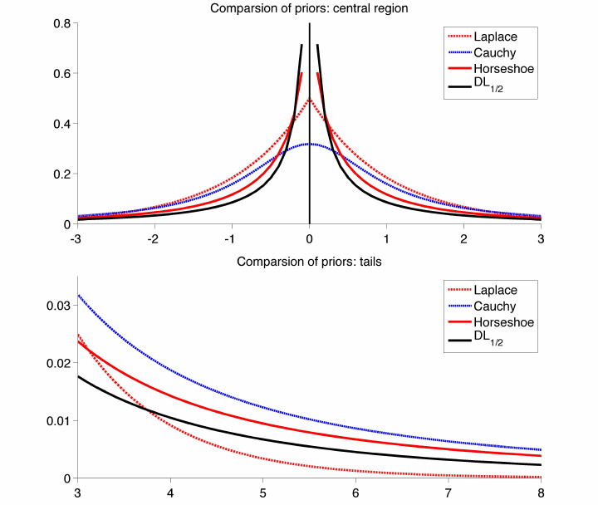
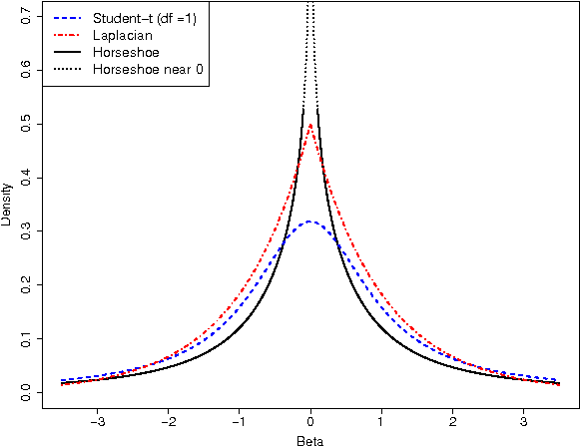
Bayesian Shrinkage Priors
Double Pareto
Global-Local Shrinkage
Horseshoe
Dirichlet Laplace

Slide 11
Bayesian Shrinkage Priors
Objective function=Log likelihood+log(prior)
Bayesian counterpart
Prior playing the role of penalty.
priors are not limited within linear likelihood. Shrinkage can be applied to the non-linear or non-gaussian likelihood

Slide 12

Bayesian Lasso

Slide 13
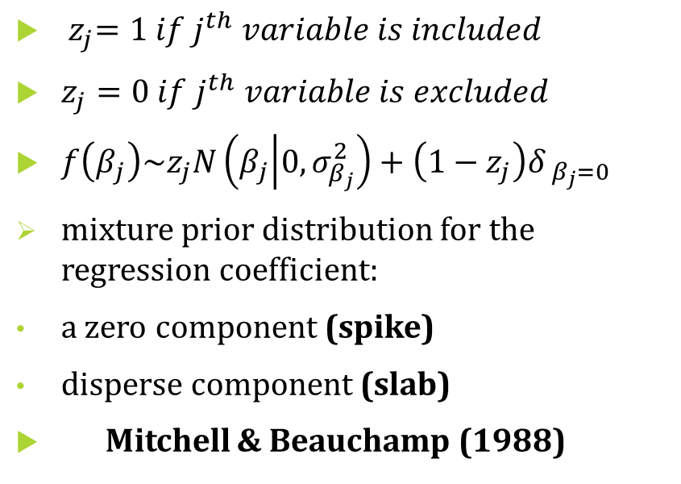
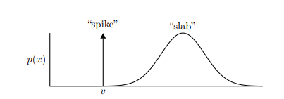
Spike and Slab Prior

Slide 14
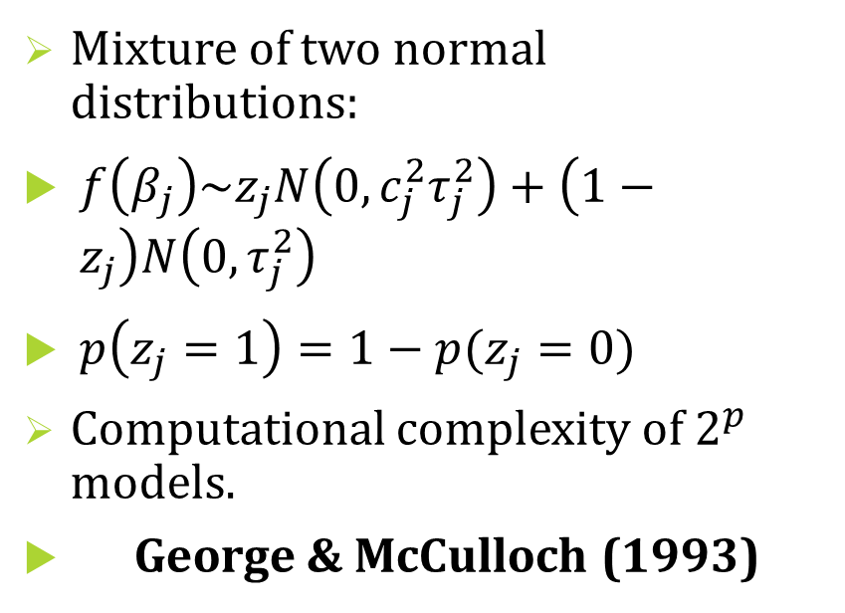
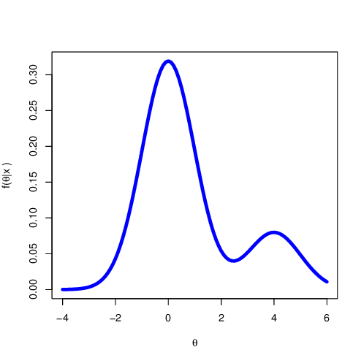
Stochastic Search Variable Selection

Slide 15
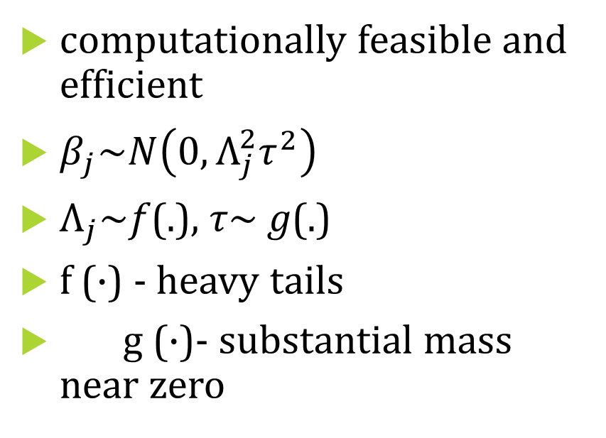
Global-Local (GL) Shrinkage Priors

Slide 16
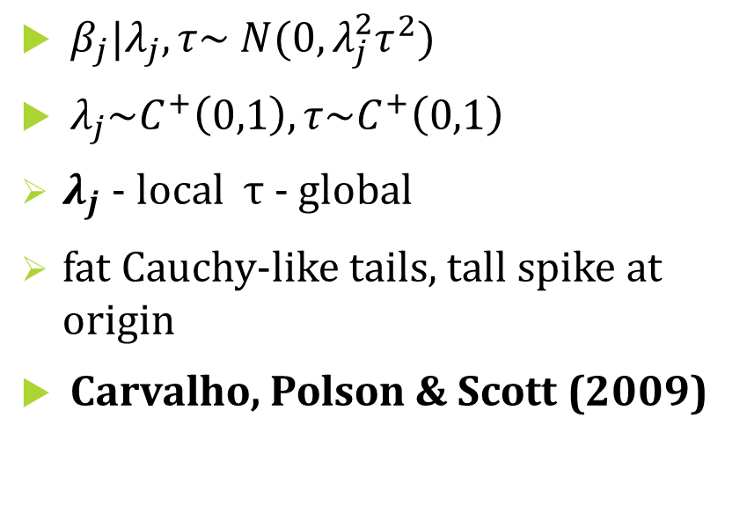
Horseshoe Prior

Slide 17
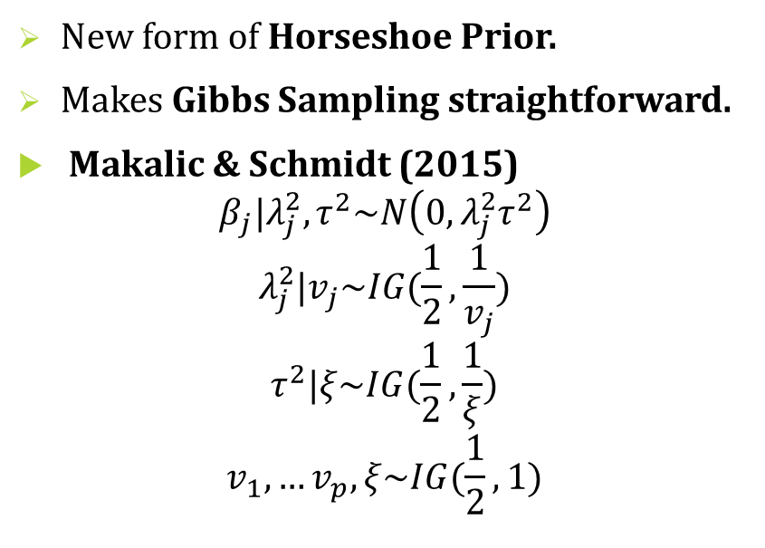
Horseshoe Prior

Slide 18
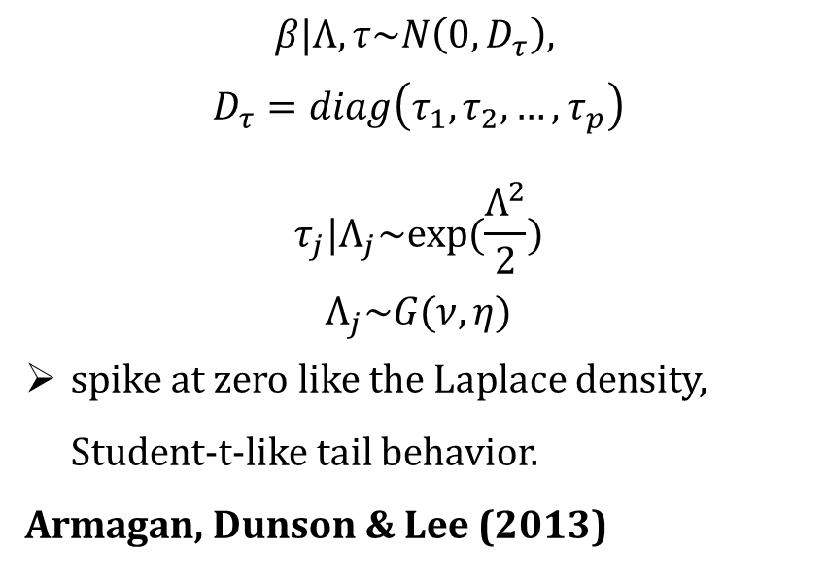
Double Pareto Prior

Slide 19
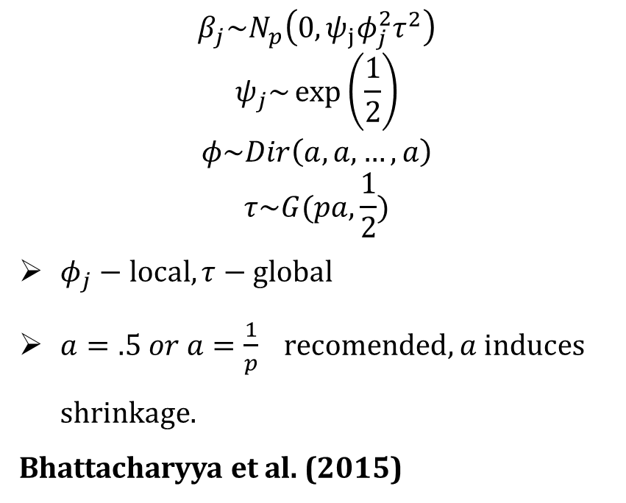
Dirichlet Laplace Prior

Slide 20
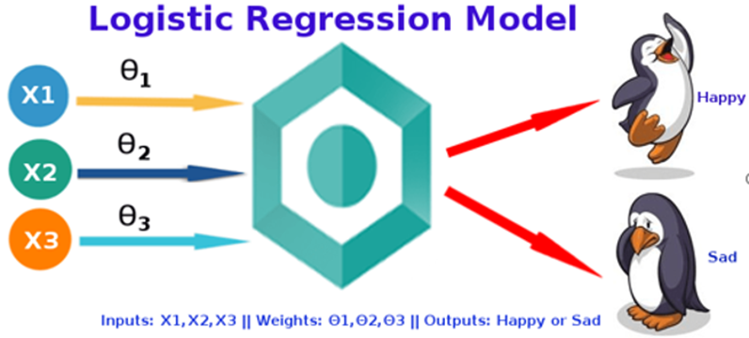

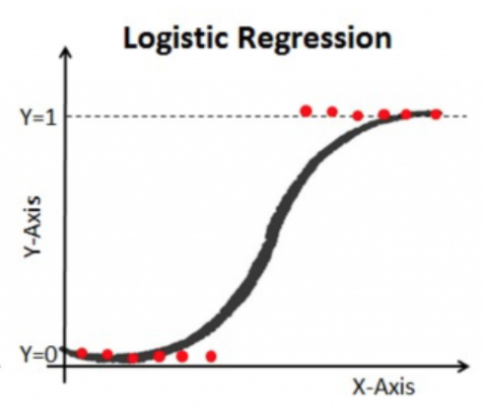
Categorical Response Models

Slide 21
Bayesian Paradigm for Categorical/Count Data
Dataset with categorical response/ count response
Polya-Gamma Data Augmentation
Prior Information
Posterior Samples by MCMC
Posterior credible intervals for Variable Selection
Prediction Performance – Accuracy, Sensitivity, Specificity, Brier Score, AUC-ROC, MSE

Slide 22
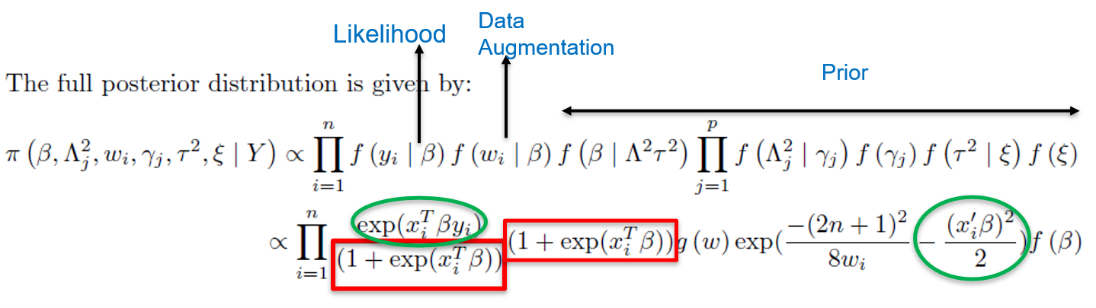
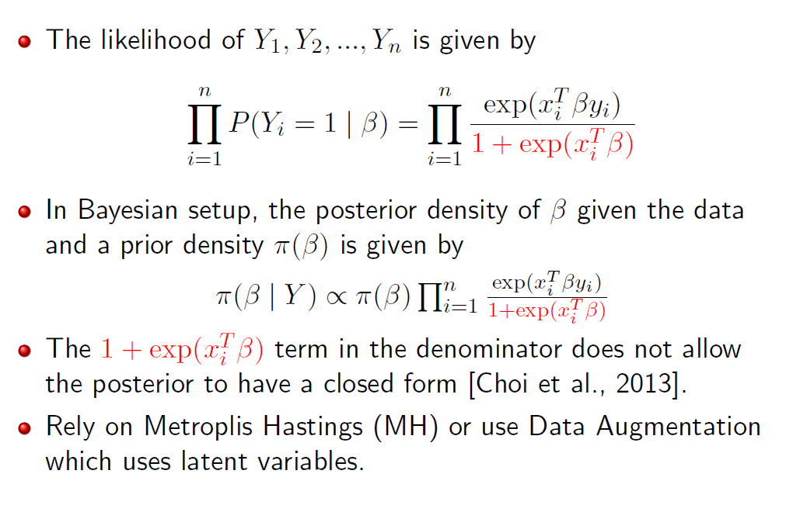
Logistic Regression with Shrinkage Priors
Need to sample from an intractable density
Data Augmentation = Posterior distributions in closed form, Gibbs Sampling

Slide 23
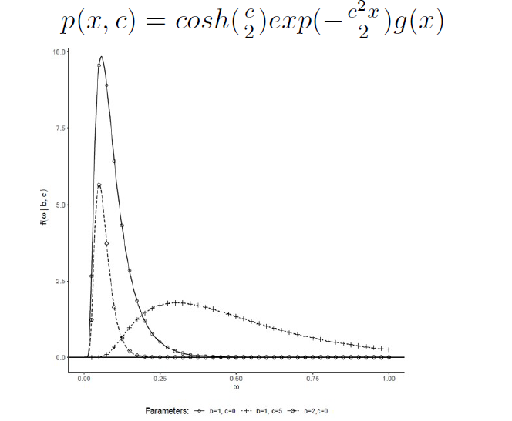

Polya-Gamma Data Augmentation

Slide 24
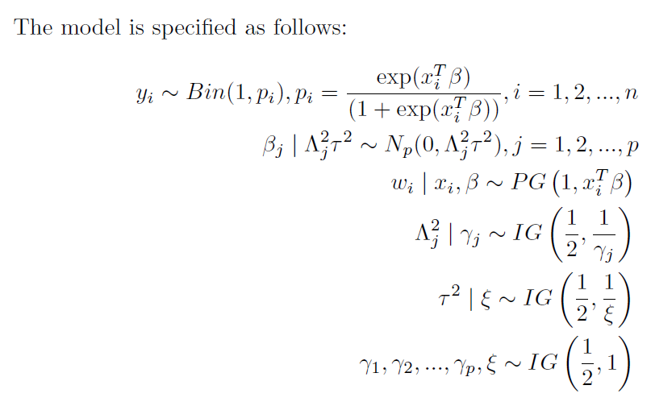
Posterior Distribution with Horseshoe and Polya Gamma in Logistic Regression

Slide 25
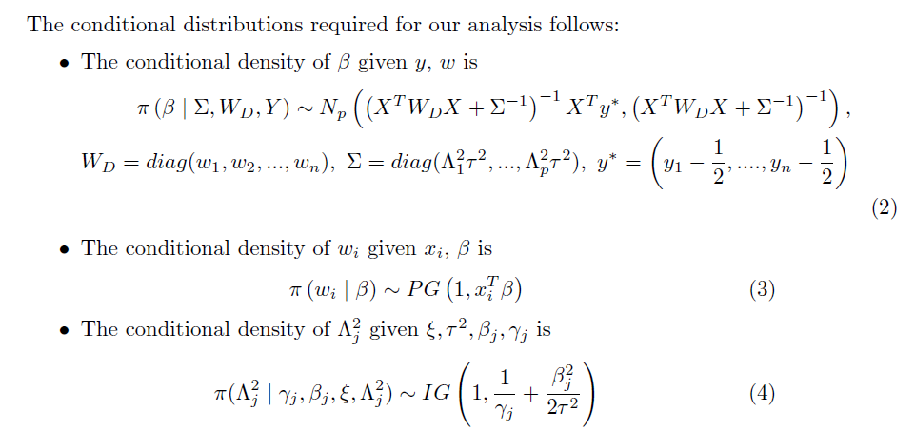
Conditional Distributions

Slide 26
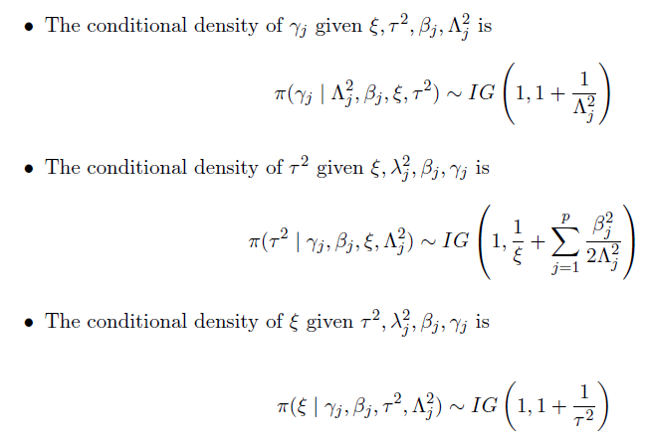
Conditional Distributions

Slide 27
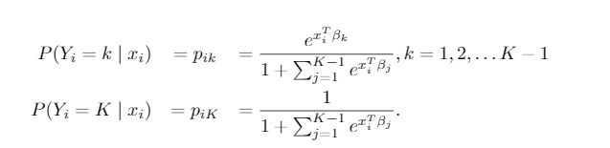
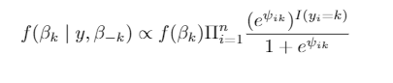
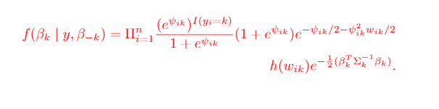
Multinomial Logistic Regression with Shrinkage Prior
Model
Full conditional with shrinkage prior for coefficients of each class
Posterior distribution for each class with data augmentation and shrinkage priors on β

Slide 28
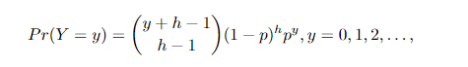
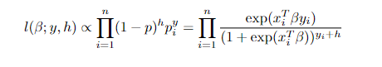
Negative Binomial Regression with Shrinkage Priors
Model
Likelihood
Shinkage priors with PG augmentation

Slide 29
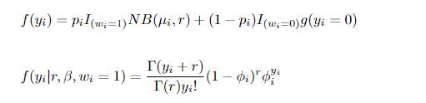
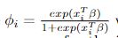
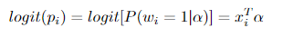
Zero-Inflated Negative Binomial Regression with Shrinkage Priors
Model
Likelihood
Shrinkage priors on both α and β and data augmentation for both the parts.

Slide 30





Results on Simulated Data

Slide 31
Prediction Module
Data
Training & Test Data
Fit the models with Training Data
Predict response with test data
Prediction Intervals for variable selection
Accuracy, Sensitivity, Specificy, AUC-ROC for prediction

Slide 32
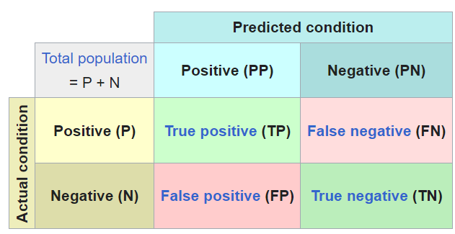
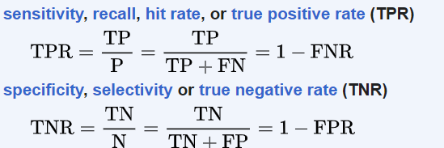
Confusion Matrix

Slide 33

Brier Score

Slide 34
Simulation Scenarios
Data was simulated with variable no. of predictors and sample sizes.
Logistic-codes.html
Negbin-Codes.html
Several set of coefficients were explored.
Model can have unpenalized baseline variables, and differential shrinkage.
Interaction terms between proxied biomarker variables and demographics were considered.

Slide 35
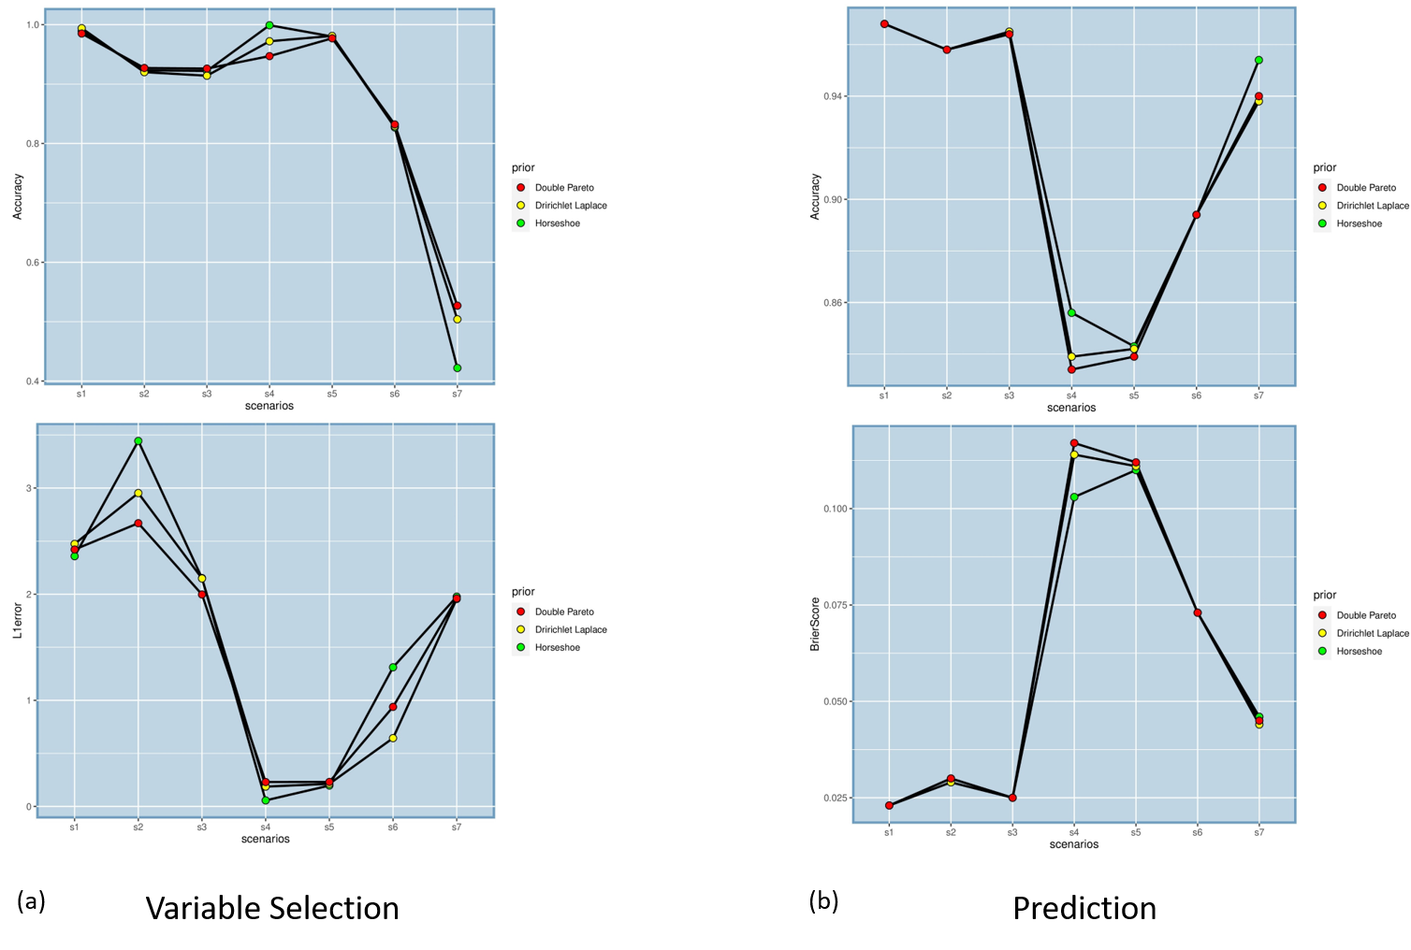
Simulation: Logistic Regression
Accuracy
Mostly metrics in the range of 0.8-0.9
Sample size increases the measures, except Brier score
Better performance on sensitivity and specificity
p>n case – prediction metrics stayed in 0.8 range
Trend continues for differential shrinkage and models with interaction terms
Brier Score

Slide 36
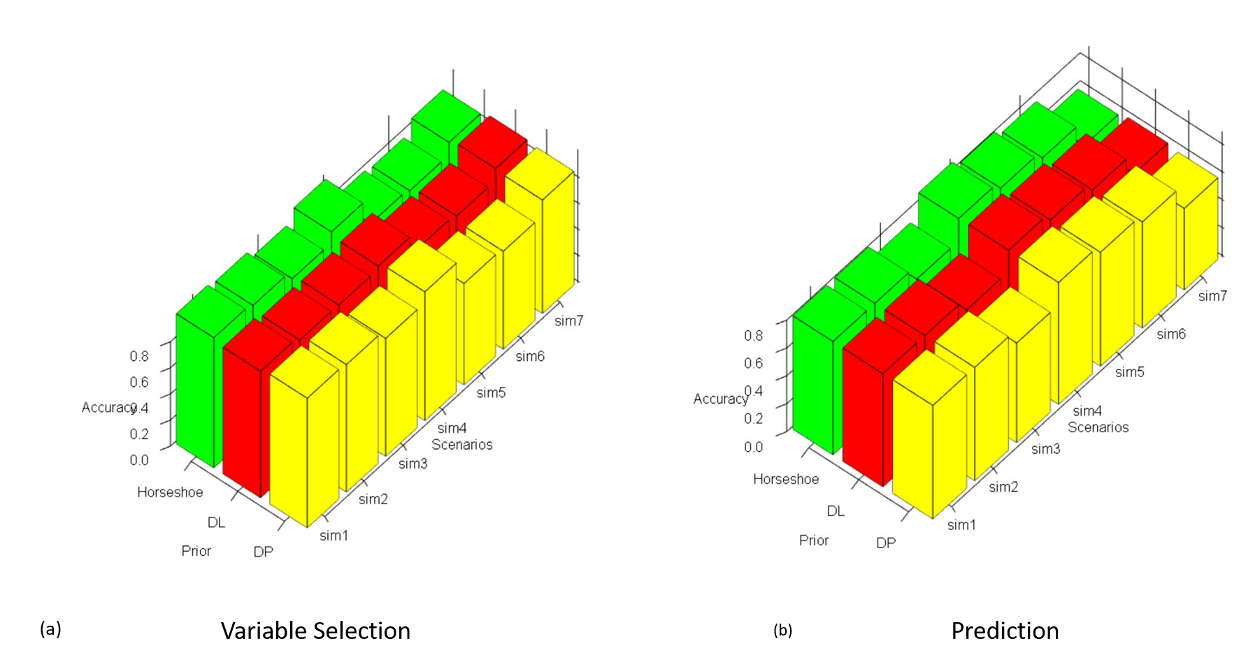
Simulation: Multinomial Logistic Regression
Accuracy
Large sample sizes drive better performance
Overall performance in the range of 0.85-0.9
More no. of classes, and proportion of zeros in coefficients impact the predictive measures
Notes:
for MLR, larger sample size, as before drives better performance. The predictive performance, in contrast, is moderate compared to the counterpart for LR, though the prediction accuracies remain above 0.8 in 4 out of the 7 simulation settings. It is seen that a larger number of classes, ie. (5 classes), reduces the predictive measures to the range of 0.7-0.8. The performances were very similar across all three priors for variable selection as well as prediction, so the method is robust to prior choices. Here in the graph, we see the accuracy of variable selection and prediction for 7 distinct simulation scenarios. The green, red and yellow bars denote the Horseshoe, DL and DP priors.

Slide 37
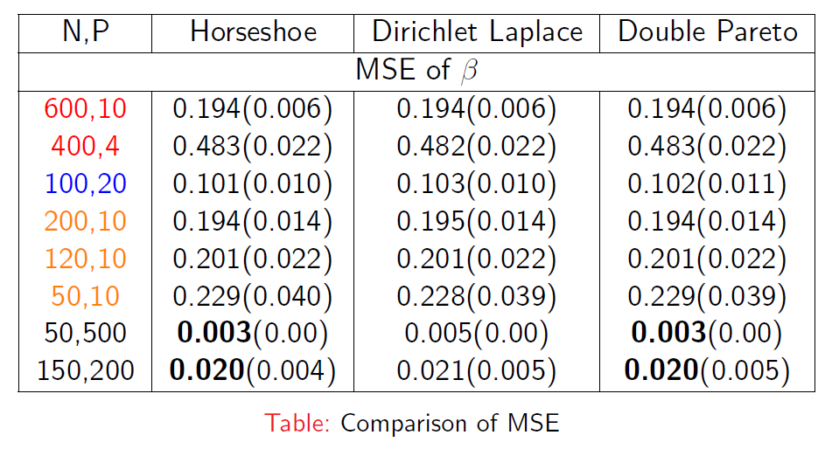
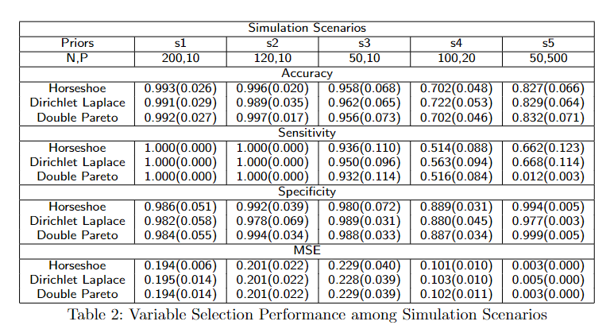
Simulation: Negative Binomial Regression
Similar trend of decrease in MSE with increase in n and p
The p>n case also have significantly reduced MSE, and performs well in selecting variables.
The variable selection performance for all the case achieves >99% on every measures, and low MSE.

Slide 38
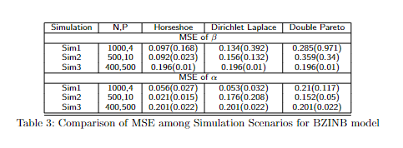
Simulation: Zero-Inflated Negative Binomial
Reduced MSE for β with increase in sample size
No pattern seen in the MSE of α
All the three priors perform similarly for p>n case

Slide 39
Application to Datasets with Binary/ Multinomial Outcomes
Diabetes
Colon Cancer
Alzheimer’s disease

Slide 40
Workflow in a nutshell
The workflow for any datas analysis consists of 3 parts – 1) Data exploration and preprocessing processing 2) Model fitting (Gibbs!) 3) diagnostics and 4) Posterior summarization(Inference)
We will walk through this workflow for a diabetes dataset using a html file next .
The next slides expand upon the diagnostics and post-Gibbs part of the workflow.

Slide 41
Diagnostics– Trace plots
are handled through the R package coda. https://cran.r-project.org/web/packages/coda/index.htmlweb/packages/coda/index.html
The most commonly used diagnostics are trace plots and autocorrelation plots.
Convergence to any distribution after a certain point- –”burn-in”--implies the samples are ‘stationary’ they have the same distribution. This would imply that any chunk of the samples will look alike. They will hover around a certain value(the posterior mean) and not fluctuate too much. Trace plots capture that.

Slide 42
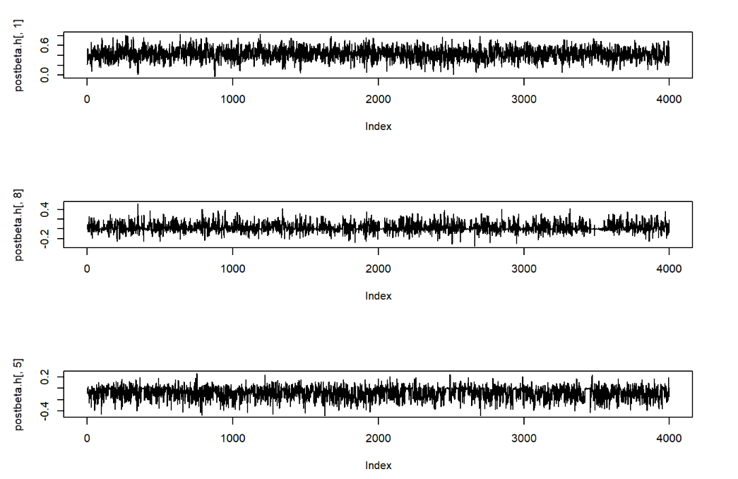
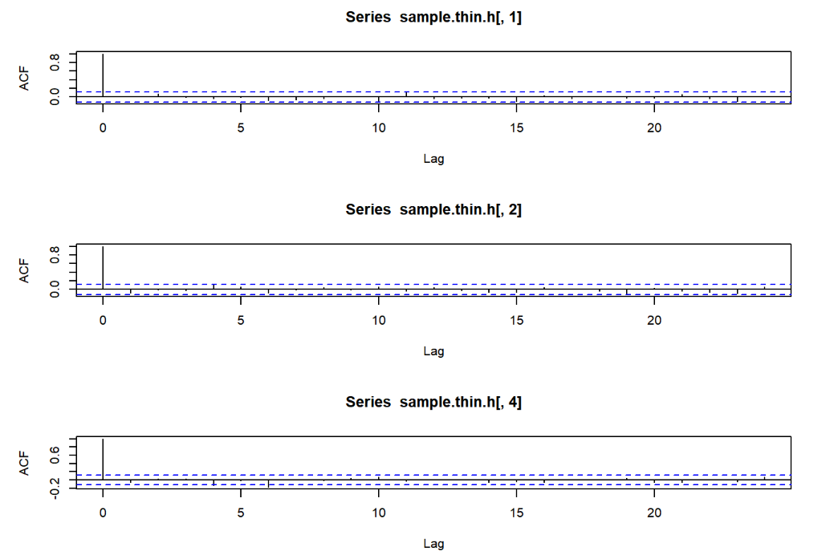
Diagnostic Plots

Slide 43
Diagnostics– Autocorrelation plots
Markov Chain Monte Carlo (MCMC) implies that the iterative algorithm produces samples that are not independent but have a Markov structure. - This hold for the entire span of the iterative cycle (even after burn-in)
-However an implication of ‘stationarity’ is that the correlation between consecutive samples after convergence will decay rapidly.
-Autocorrelation captures that.

Slide 44
Inference: Summarizing posterior
Summarization follows diagnostics. Unlike frequentist domain, any question on the parameter mean, parameter uncertainties and of any complicated functions thereof, can be answered directly in one step. -Just through straightforward summaries of the MCMC samples.
For example, posterior mean is the average of the corresponding MCMC samples, and posterior credible intervals can be derived from the empirical quantiles of the samples.
That’s it ! The accompanying html files will walk us through an entire Bayesian workflow in R on a couple sample datasets.

Slide 45
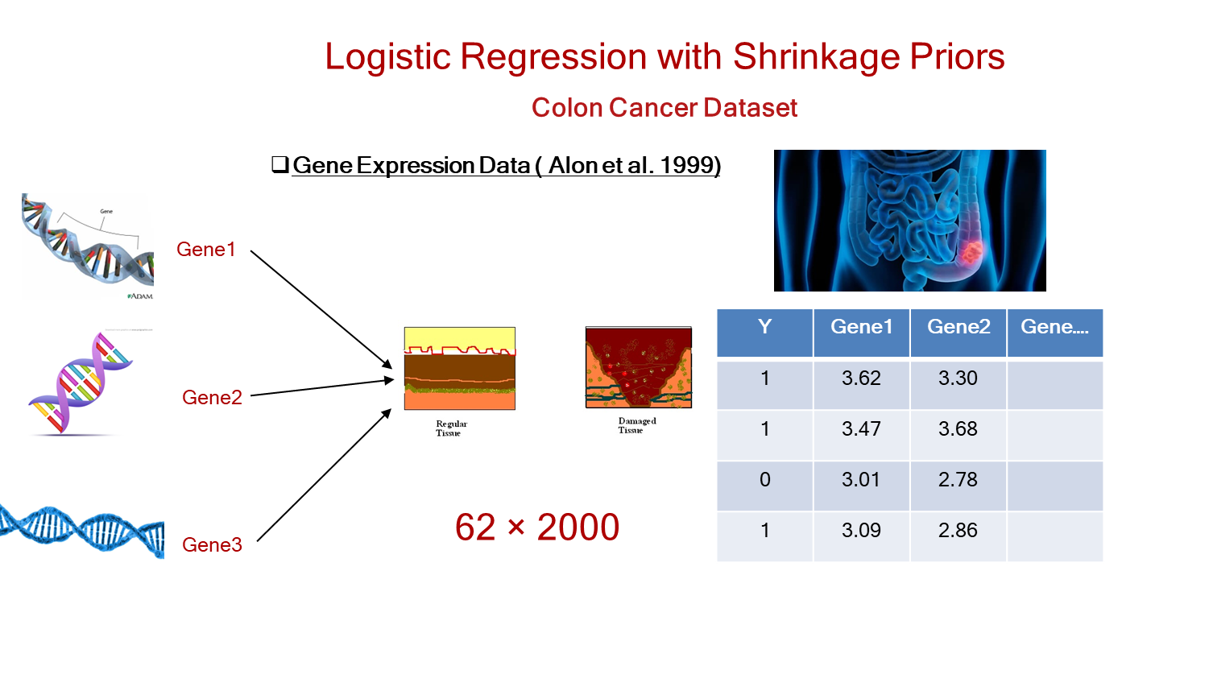
Colon cancer data Predictors: 2000 human genes from 40 tumors and 22 normal colon tissues.
-HS performs best in all measures and selects 36 genes out of 2000
Measures | Horseshoe | Dirichlet Laplace (DL) | Double Pareto (DP)
Accuracy | 0.846 | 0.769 | 0.769
Sensitivity | 1.000 | 0.750 | 0.750
Specificity | 0.778 | 0.778 | 0.778
AUC | 0.889 | 0.764 | 0.764
Brier Score | 0.121 | 0.224 | 0.240

Slide 46
Other case studies : Alzheimer’s disease, Dementia
Public domain ADNI database: available from R package ADNI merge.Five progressively increasing categories of mental impairment– (1) Normal, (2) Early Mildl [3] Late Mild [4] Subjective Complaint [5] Alzheimer’s.
MLR regression applied. Among a host of demographic (age, education gender), race ),cognitive tests, and clinical predictors (brain volume) all three priors selected 13-item AD cognitive scale score and auditory learning test scores All three had around 95% accuracy and greater than 90% specificity. - Oasis database: Absent/Mild/severe dementia outcomes . Among several clinical and demographic factors, normalized brain volume mental state exam scores selected by our methods.
-Results from datasets shown in a compressed figure next. Also discussed in detail –https://bmcmedresmethodol.biomedcentral.com/articles/10.1186/s12874-022-01560-6

Slide 47
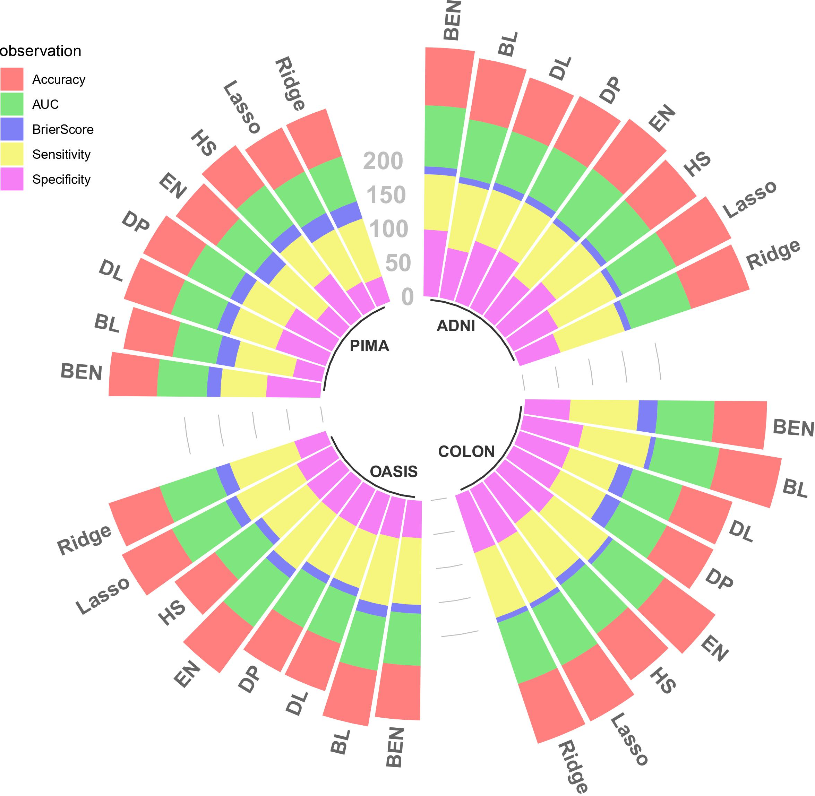
Summary across datasets
In a nutshell -
Our proposed method with the horseshoe prior outperformed frequentist methods on specificity by as much as 10 percentage points in all datasets. The colon dataset has the second highest AUC from our method only superseded by Blasso.
HS: Horseshoe, EN: Elastic-Net, DP: Double Pareto, DL: Dirichlet Laplace, BL: Bayesian Lasso, BEN: Bayesian Elastic Net

Slide 48
Negative Binomial Case study: Biochemists data
Response: Post-PHD Publications by Biochemists
- Public domain data available from R package pscl.
Variables– Gender marital status , # children under age six, prestige of the PHD program, # articles by the mentor in last 3 years, # PHD publication volumes.
Prestige and Phd performance selected as important predictors.
The accompanying html file walks through this case study.

Slide 49
Case studies for count data:
Genomics data.
-RNA-seq count data apt for applying a Bayesian NB or zero inflated Bayesian NB models. In next generation sequencing, expressions are counts.
Many publicly available databases like GEO.
> 50000 genes. Applied the BNB models to these high-dimensional datasets. Working on biological interpretation.

Slide 50
Methodological extension to graphical models.
Graphical/Network models infer association between variables by assessing conditional independence.
-These inference can be done computationally efficiently through an ensemble of neighborhood regressions. Very informally, the idea < regress one variable on the rest and circulate.>
–A very fast comprehensive Bayesian model was proposed for recently, but only for normally distributed continuous outcomes.
- Thus, Count/categorical graphical model can be an immediate offshoot from our current work. Gene network inference straightforward.

Slide 51
Priors vs penalties: Common ‘prior’ misconceptions
Priors NOT equivalent to external information! but can include them flexibly if needed. If we had clinical information about the importance of a variable we could surely include that. Easy code tweaking,
-However, more generally priors can incorporate non-variable specific structural information. For example, we may want to impose that most variables are non-significant but don’t specify which.
Adding priors can’t hurt likelihood-based analysis! At the worst it (large samples) the latter or (in case of reliable informative or structural information) improves it. –Hierarchical Bayesian models allow us to choose prior settings in an automated way unlike choosing penalties by cross-validation

Slide 52
Discussion
The model relies on linking Polya-Gamma Data-Augmentation and Shrinkage Priors.
Computationally quite scalable.
Competitive against traditional methods..
Hierarchical setup amenable to include several Bayesian priors including other shrinkage priors.

Slide 53



Future Work
Bayesian Graphical Networks for Count/Categorical variables
Extension to semi-informative priors
Using interaction in regression and subgroup finding in real-world clinical trial design
Make the R codes public as an R package.

Slide 54
Acknowledgement
Dr. Shesh N. Rai*
Dr. Subhadip Pal*
*Department of Bioinformatics & Biostatistics, University of Louisville, KY

Slide 55
References
Park, T., & Casella, G. (2008). The Bayesian Lasso. Journal of the American Statistical Association.
Polson, N. G., Scott, J. G., and Windle, J. (2013). Bayesian inference for logistic models using polya-gamma latent variables.
Tibshirani, R. (1996). Regression Selection and Shrinkage via the Lasso. Journal of the Royal Statistical Society B.
Bhattacharya, A., Pati, D., Pillai, N. S., and Dunson, D. B. (2015). Dirichlet-laplace priors for optimal shrinkage. JASA
Armagan, A., Dunson, D. B., and Lee, J. (2013). Generalized double pareto shrinkage. Statistica Sinica
Choi, H. M., Hobert, J. P., et al. (2013). The polya-gamma gibbs sampler for bayesian logistic regression is uniformly ergodic. Electronic Journal of Statistics
Bhattacharyya, A., Pal, S., Mitra, R. et al. Applications of Bayesian shrinkage prior models in clinical research with categorical responses. BMC Med Res Methodol 22, 126 (2022). https://doi.org/10.1186/s12874-022-01560-6

Slide 56


Thank You
This Photo by Unknown Author is licensed under CC BY
Notes:
The slides after this are meant not to be used. I haven’t just deleted them- RM

Slide 57
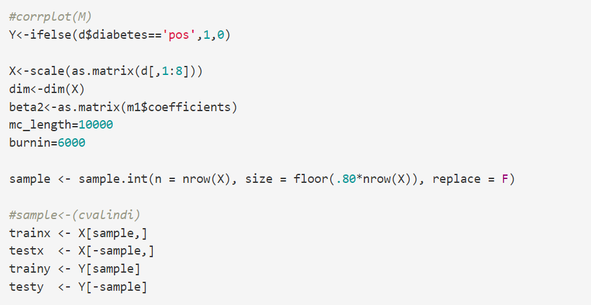
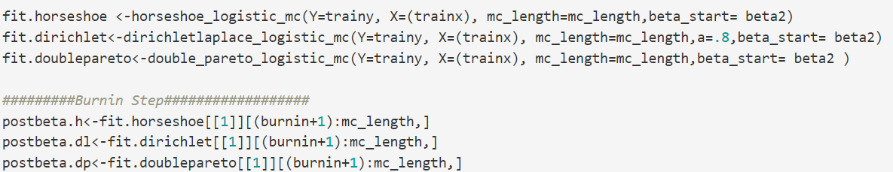
Pima Indian Diabetes Data
markdownPima.html

Slide 58

The three priors detect four variables as significant by 95% credible intervals. These are –“pregnant,” “glucose,” “mass (BMI),” and “pedigree (family history)” In prediction,, frequentist methods have low specificity values

Slide 59


Negative Binomial Case Study Biochemists data
Response: Post-PHD Publications
Variables– Gender marital status , # children under age six, prestige of the PHD program, # articles by the mentor in last 3 years, # PHD publication volumes.
Prestige and Phd performance selected.

Slide 60


Logistic Regression Case Study
Pima Indian Diabetes Data

Slide 61



Variable Selection & Prediction for Pima Indian Diabetes Data

Slide 62


Model Diagnostics

Slide 63

Variable selection for Biochemists Data
The no. of children under age six (x3) and the no. of articles by the mentor in the last three years (x5) were the most significant variables.

Slide 64


Biochemists Data Results
Biochemists: Gender (x1), marital status (x2), the number of children under age six (x3), prestige of Ph.D. program (x4), and the no. of articles by the mentor in last three years (x5). Y: No. of PhD publications

Slide 65


Fitting a Negative Binomial Model in R
biochemists.html

